Slide 1

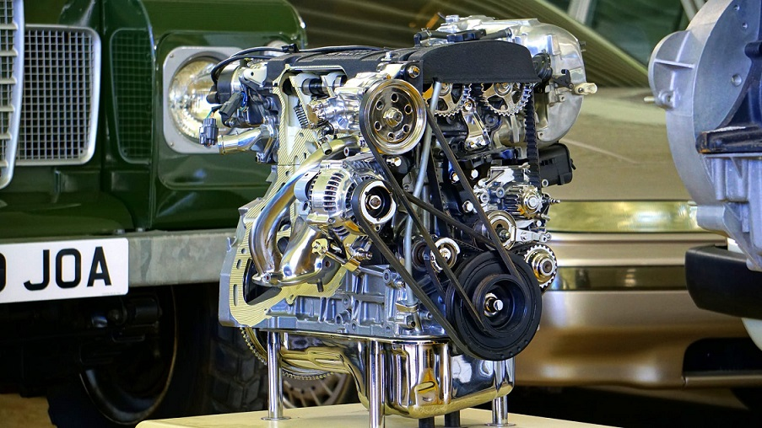
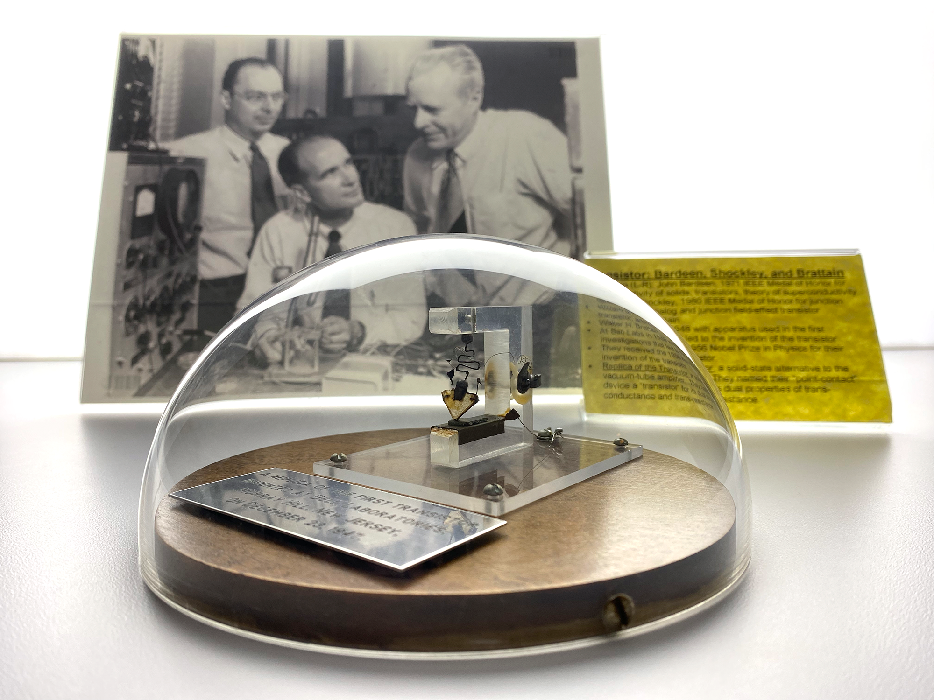





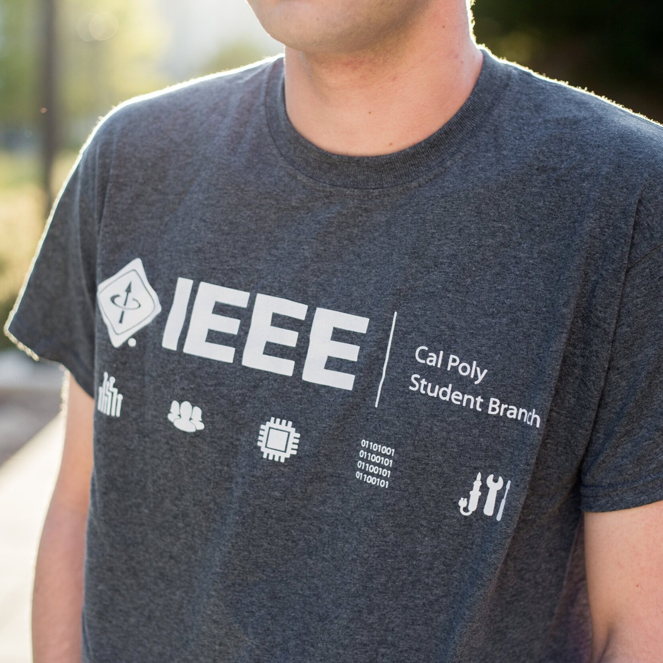

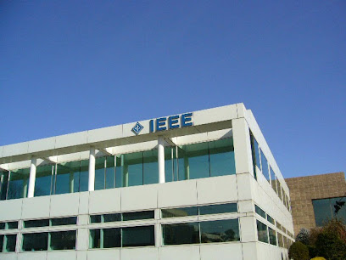
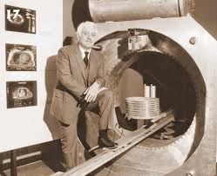


VIT Bhopal Student Branch
STB 11518

Slide 2

1.
1.
1.
1.
VIT Bhopal Student Branch
STB 11518
1.
1.

Slide 3


STB 11518
1
6
Consist of individuals who come together with a common goal of mastering a particular subject or skill.
Small sized to facilitate one-to-one interaction, and personalized attention.
5
2
Leverage the strengths and expertise of individual members. Peer-to-peer learning is a key component.
Designed to enhance collective learning through shared objectives and mutual support.
Emphasize practical application of knowledge. engaging in hands-on activities, projects, or real-world problem-solving
3
4
Members of focused learning groups collaborate to share knowledge, resources, and experiences.

Slide 4




Recognition and Growth: Student’s contributions will be celebrated. From featuring in our magazines and social media to awards and certifications, we’ll make sure all hard work stands out.
Hands-On Projects: Engage in practical, real-world projects that let you apply your knowledge and work with peers who share your interests. It’s not just about learning – it’s about doing and creating.
Expert-Led Workshops: Participate in exclusive workshops led by industry leaders and experts. These sessions will keep you ahead of the curve and provide you with skills that are highly sought after.
YOUR GATEWAY
TO
OPPORTUNITIES
STB 11518

Slide 5
Networking Opportunities: Build meaningful connections with peers, alumni, and industry professionals. These relationships could become invaluable as you advance in your career.
Skill Development: Enhance your skills through practical, hands-on experiences in a collaborative environment.
04
01
1SHAPE YOUR EXPERIENCE: Participate in polls to influence the content and format of our sessions. Whether you want interactive workshops or online seminars, your feedback will guide our offerings.
2We’ve set up dedicated Discord communities for each Focused Target Group
4Learn and Connect: Access a wealth of knowledge through webinars, Q&A sessions, and tech talks with industry experts and successful alumni.
3ENGAGE SEAMLESSLY: Chat in real-time and share resources with ease. Our Discord channels are organized to keep everything streamlined and productive.
VIT Bhopal Student Branch
STB 11518
03
02
Alumni and Expert Mentorship: Benefit from the guidance of experienced alumni and professionals who can offer advice, support, and opportunities
Interactive Events: Join in on hackathons, study sessions, and other engaging events designed to keep you motivated and involved.

Slide 6
EAGER TO BE PART OF A COMMUNITY WHERE YOUR SKILLS ARE HONED,
Join us in shaping the future of engineering and technology. We’re excited to see what we can achieve together!
EAGER TO BE PART OF A COMMUNITY WHERE YOUR SKILLS ARE HONED,
FTG is the place for you. It’s a chance to be part of something bigger, to innovate, and to make a real impact.
Networking Opportunities: Build meaningful connections with peers, alumni, and industry professionals. These relationships could become invaluable as you advance in your career.
02
01
03
Skill Development: Enhance your skills through practical, hands-on experiences in a collaborative environment.
04
01
03
02
DELIVERING VALUE
Alumni and Expert Mentorship: Benefit from the guidance of experienced alumni and professionals who can offer advice, support, and opportunities
Interactive Events: Join in on hackathons, study sessions, and other engaging events designed to keep you motivated and involved.
STB 11518

Slide 7
EAGER TO BE PART OF A COMMUNITY WHERE YOUR SKILLS ARE HONED,
EAGER TO BE PART OF A COMMUNITY WHERE YOUR SKILLS ARE HONED,
Join us in shaping the future of engineering and technology. We’re excited to see what we can achieve together!
FTG is the place for you. It’s a chance to be part of something bigger, to innovate, and to make a real impact.
01
02
03
STB 11518

Slide 8

STB 11518
https://discord.gg/RwjFNHgV

